Slide 1
ACTIVE SHOOTER RESPONSE MODULE FOR CS BUILDING USING UNITY
Sri Teja Bodempudi
Manik R Arrolla

Slide 2

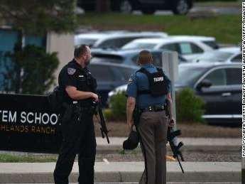
RECENT ACTIVE SHOOTING INCIDENT
Two suspects entered the STEM School Highlands Ranch near Denver on May 7 and opened fire.
Left one student dead and eight others injured.

Slide 3
OUTLINE
GOAL
ACTIVE SHOOTER
EMPLOYEE SIMULATION (ES)
ES RUN
ES HIDE
ES FIGHT
POLICE SIMULATION
RESOURCES
GAME DEMO
CONCLUSION
REFERENCES

Slide 4
GOAL
What to do if you find yourself in an active shooting event.
What to expect after an active shooting takes place.
What to Remember during an active shooting .

Slide 5
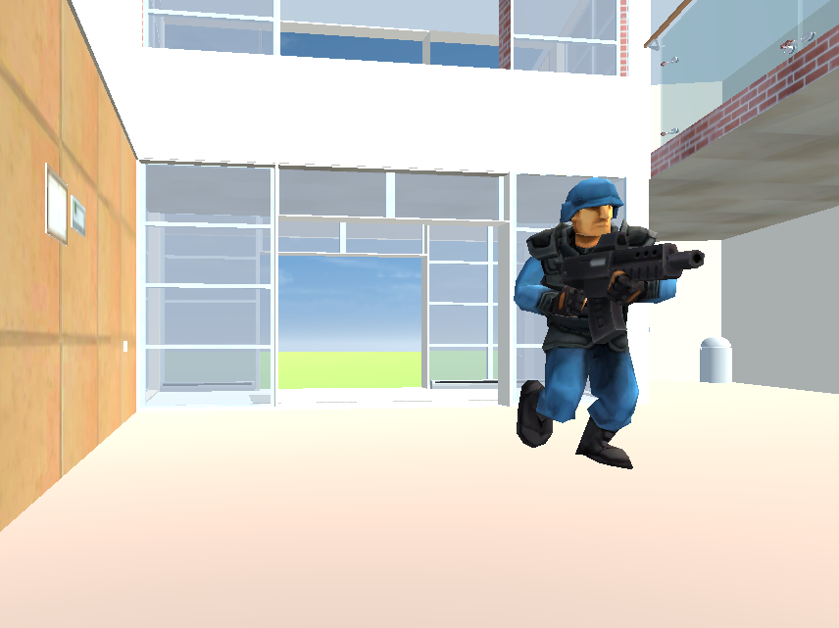
ACTIVE SHOOTER
Active shooter situations are unpredictable and evolve quickly.
Active shooter situations are often over within 10 to 15 minutes, before law enforcement arrives on the scene.
Individuals must be prepared both mentally and physically to deal with an active shooter situation.
Active shooters use ﬁrearms and there is no pattern or method to their selection of victims.

Slide 6
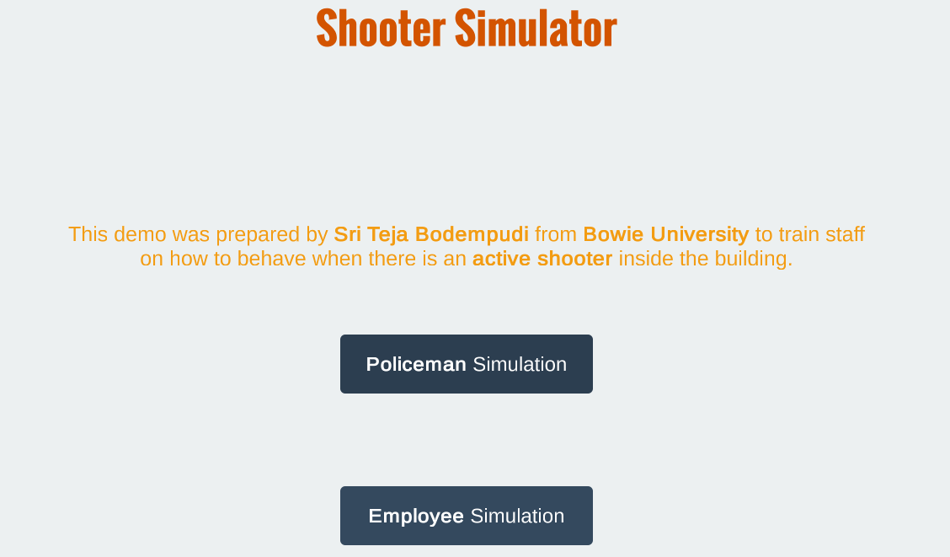
EMPLOYEE SIMULATION (ES)
Simulation training helps employees experience real-world examples and get up to speed faster.
Simulation training is done with a virtual environment that mirrors actual work conditions, including background noise, effects, and simulated workspaces.

Slide 7
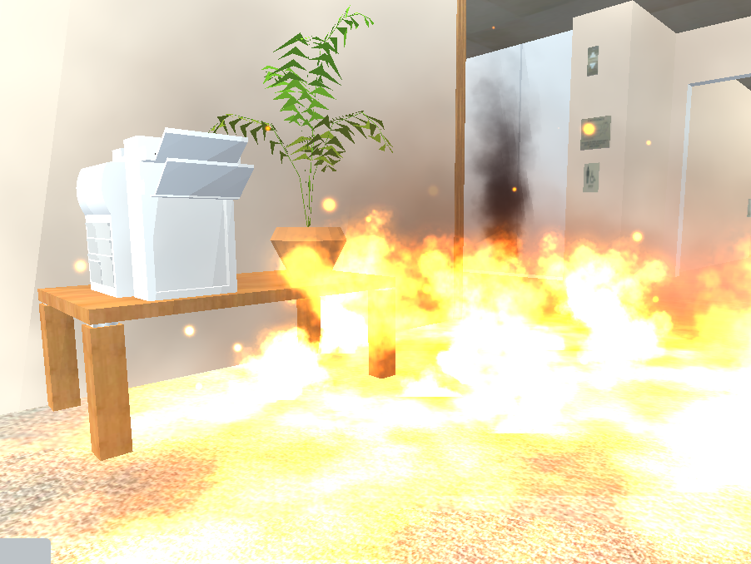
RUN AND ESCAPE, IF POSSIBLE.
Getting away from the shooter or shooters is the top priority.
Leave your belongings behind and get away.
Help others escape, if possible, but evacuate regardless of whether others agree to follow.
Warn and prevent individuals from entering an area where the active shooter may be.
Call 911 when you are safe, and describe shooter, location, and weapons.

Slide 8
HIDE, IF ESCAPE IS NOT POSSIBLE.
Get out of the shooter’s view and stay very quiet.
Silence all electronic devices and make sure they won’t vibrate.
Lock and block doors, close blinds, and turn off lights.
Don’t hide in groups- spread out along walls or hide separately to make it more difficult for the shooter.
Try to communicate with police silently. Use text message or social media to tag your location.
Stay in place until law enforcement gives you the all clear.
Your hiding place should be out of the shooter's view and provide protection if shots are fired in your direction.

Slide 9
FIGHT AS AN ABSOLUTE LAST RESORT.
Commit to your actions and act as aggressively as possible against the shooter.
Recruit others to ambush the shooter with makeshift weapons like chairs, fire extinguishers, scissors, books, etc.
Be prepared to cause severe or lethal injury to the shooter.
Throw items and improvise weapons to distract and disarm the shooter.

Slide 10
POLICE SIMULATION
Gives practical experience and decision-making skills needed to successfully resolve emergency related incidents.
Rescue the individuals who are trapped inside the building.
Gives high priority in eliminating the target(Active shooter).

Slide 11
RESOURCES
https://www.youtube.com/watch?v=ZvkdGK2j2Bs&t=150s

Slide 12
GAME DEMO

Slide 13
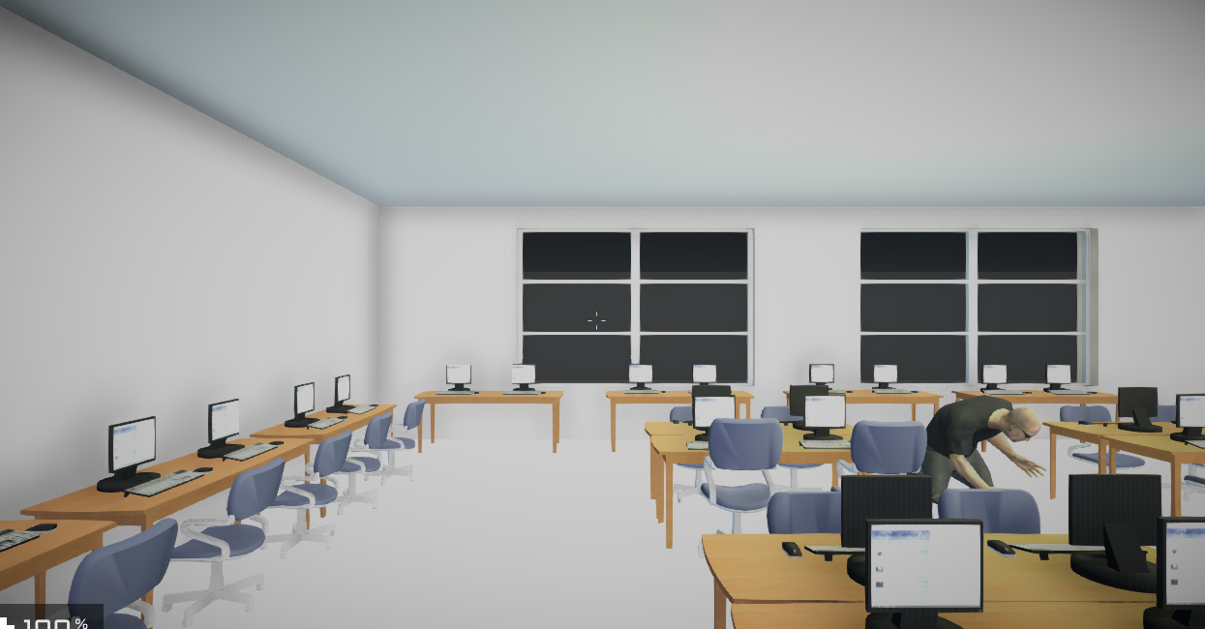
FUNCTIONALITY
Vision: Floor plans of the BSU CS building.
Sound: shooting, explosion, screaming sounds to feel realistic.

Slide 14
FUNCTIONALITY
Animation: Shooting the target and navigating the people to exit the building.
Interactivity: To Move, keyboard events and To fire, mouse events are used in this project.
Sensors: Proximity, Time, Touch are used in this project.
Avatars: Unity First person controller, Third person controller, Different characters.

Slide 15
CONCLUSION
Helps visualize possible escape routes, including physically accessible routes. We were able to perform successfully Active shooter response module for CS building using Unity.

Slide 16
THANK YOU & QUESTIONS?

